Slide 1

vLLM Inference Optimization
Area SciencePark— (Trieste, Italy) — 19/01 – 19/02
Ben Mlouka badis
Mentor: Alberto Cazzaniga
Notes:
1

Slide 2
Area Science Park & LADE: what they do?
Area Science Park
National public research organization (since 1978) supervised by the Italian Ministry of University & Research
Manages a leading Science & Technology Park.
Bridges research and industry: technology transfer, deep-tech innovation, digital/green transformation
Provides shared research/technological infrastructures and innovation services to support projects
LADE — Laboratory of Data Engineering
Research infrastructure focused on AI and data engineering: extracting knowledge/value from data
Develops advanced data management and AI methods
Provides and operates the HPC/data services backbone

Slide 3
Technologies used
vLLM
Open-source LLM inference & serving engine designed for high throughput.
Uses PagedAttention to manage the KV cache efficiently
Implements continuous batching to keep GPUs busy under concurrent requests.
Provides an OpenAI-compatible API server.
Locust
Load testing tool to simulate many concurrent users hitting an API
Measures latency, throughput, and error rate
LM Eval
Benchmarking framework to compute LLM accuracy scores on standard tasks
Can evaluate models served via an OpenAI-compatible endpoint
ORFEO
Area Science Park’s high-performance computing
Designed for large-scale data processing
Provides advanced GPU/HPC resources to support training & inference workloads
Kubernetes
System to deploy, scale, and manage containerized applications
Standard way to run reproducible services on a cluster
Used to operate vLLM inference services reliably
Notes:
2

Slide 4
Internship timeline
Week 1 :
Understand ORFEO, Kubernetes deployment workflow
Study vLLM fundamentals
Reproduce a baseline deployment and sanity tests
Week 2
Build Locust scenarios to stress the vLLM endpoint
Define KPIs: tokens/s, latency, error rate, GPU memory usage
Select tunable vLLM parameters
Weeks 3 - 4
Run controlled experiments
Compare performance vs stability
Check accuracy impact and summarize best trade-offs

Slide 5
Locust Baseline Results, Throughput Comparison
Ran Locust load tests against vLLM
Exported stats per run and consolidated them into CSV datasets.
Computed tokens/s distributions and latency distributions to visualize
Derived tuning targets: max_num_seqs, max_num_batched_tokens, enable_chunked_prefill, max_model_len, gpu_memory_utilization.
GPT: very high throughput overall.
Qwen3: medium typical throughput with spikes.
Llama: low most of the time with rare peaks.

Slide 6
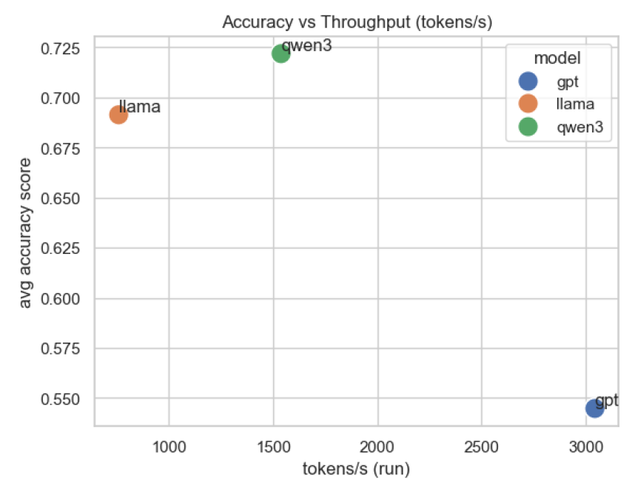
Model Comparison: Speed vs Quality (LM Eval and Locust)
Measured throughput/latency with Locust under the same load scenario for each model.
Measured accuracy with LM Eval on 5 benchmarks (ARC, GSM8K, HellaSwag, TruthfulQA MC2, WinoGrande).
Merged results into one plotted Accuracy vs Throughput to identify the best trade-off
Qwen3: highest average accuracy with solid throughput
GPT: throughput-first: fastest but lowest accuracy, especially weak on GSM8K.
Llama: strong accuracy and best on GSM8K, but slower.

Slide 7
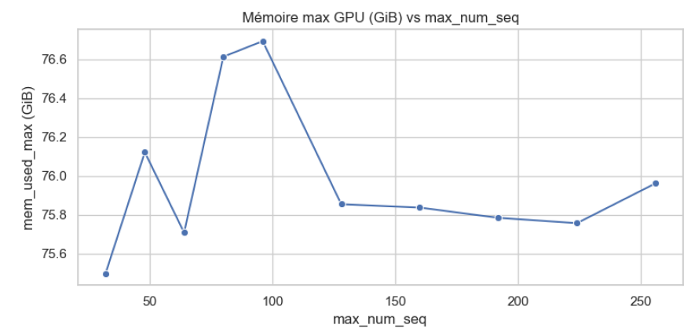
GPT-OSS Optimization
Ran controlled parameter sweeps (one-parameter-at-a-time) on the vLLM deployment.
Collected: peak/mean GPU memory, throughput, latency stats, and benchmark accuracy
Used normalized per-task accuracy and a memory vs accuracy trade-off plot to pick robust operating points.
Validated improvements with a before/after comparison to ensure system-level gains without quality loss.

Slide 8
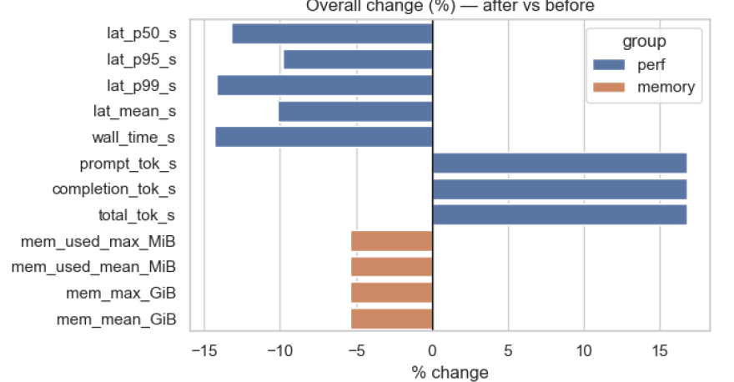
Before vs After - GPT Optimization Impact
Throughput: total & completion tokens/s +16–17% (prompt tok/s improves too).
Latency: p50 / p95 / p99 / mean −10–14% improvements also on tail latency.
GPU Memory: peak & average VRAM −5.4% (~4.2 GiB saved) → more headroom, lower OOM risk.
Accuracy: stable overall (ARC & GSM8K unchanged; tiny HellaSwag drop; small Winogrande gain).

Slide 9

Next Steps
Optimize Qwen3 and Llama 4: run the same tuning workflow, I didn’t have enough time to complete it.
Expand the parameter search: include gpu_memory_utilization, max_model_len, and KV-cache related settings; explore interactions
Workload realism: test multiple prompt/response lengths and different concurrency profiles.
Automation: one-command pipeline to run sweeps, collect metrics and generate plots/report.
Scaling experiments: vary GPU allocations and multi-replica serving on Kubernetes (load balancing).
Notes:
4

Slide 10
Challenges & Difficulties
Cluster operations: pod restarts, deployment debugging, and ensuring stable endpoints on Kubernetes
Resource constraints: GPU memory limits (KV-cache pressure), occasional OOMs, and finding safe operating points
Performance variability: long-tail latency and throughput variance under concurrency
Benchmarking consistency: keeping the same workload across runs (prompt length, concurrency, limits) to make results comparable
Time constraint: focused optimization completed for GPT; Qwen3 and Llama 4 optimization not finished

Slide 11
Thank you
Alberto Cazzaniga, Internship supervisor, guidance and support throughout the project
Isac, Help with access, infrastructure, and troubleshooting
Niccolò, Careful review of my reports and valuable feedback/advice
Thank you to the LADE / Area Science Park team for the welcoming environment and support
badis.ben-mlouka@utbm.fr
Notes:
5

